Slide 1

AWS-Based Superstore Data Analysis: A Research-Oriented Approach
Marcelo Vicente and Harry Depina

Slide 2



Project Introduction
Build an end-to-end cloud-based data pipeline using AWS services
Analyze retail sales data from a superstore dataset
Gain practical experience with real-world cloud-based business intelligence workflows
Leverage AWS cloud infrastructure to ingest, process, and analyze retail sales data.
Gain insights and business intelligence from the superstore's sales and customer data.
Learn how to implement and optimize cloud-based data pipelines for data-driven decision making.
This project aims to provide a comprehensive understanding of cloud-based data engineering and analytics using AWS services, with a focus on gaining practical experience and learning rather than solving a specific business problem.

Slide 3
Solution Overview: AWS Architecture
Components Used
Solution Objective
Benefits of this Solution
- Amazon S3 for storage - AWS Glue for metadata cataloging and data crawling - Amazon Athena for serverless SQL-based querying - (Optional) Amazon QuickSight for visualization
Automate ingestion, cataloging, and querying of retail data on the AWS cloud
- Serverless architecture = reduced management overhead - Scalable storage and compute power - Low cost due to query optimization via partitioning

Slide 4
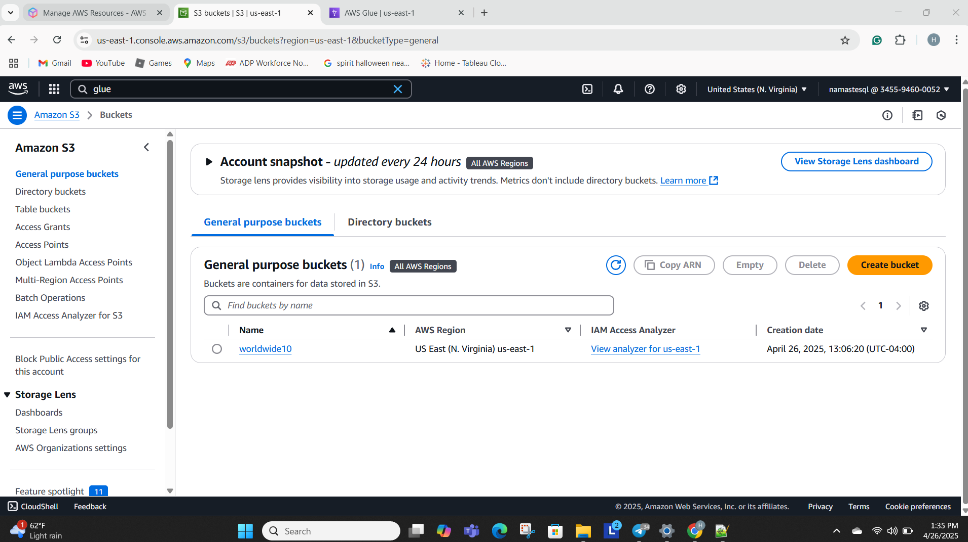
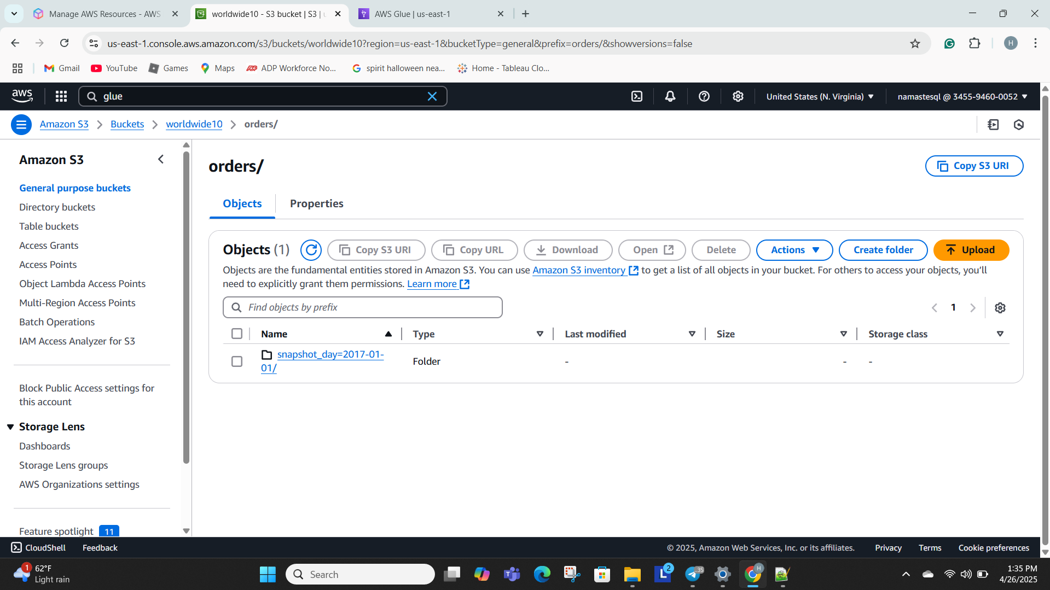
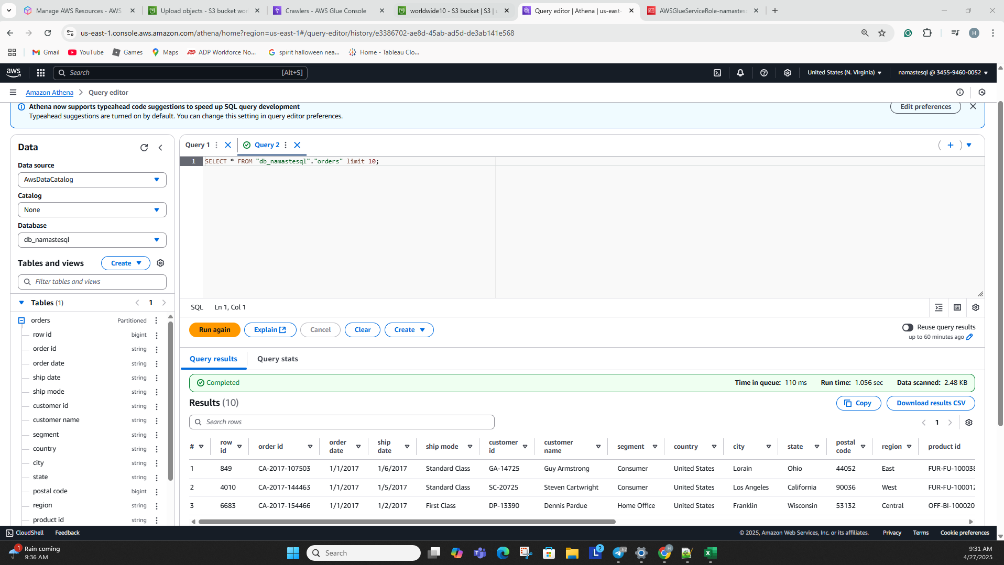
Architecture Setup: AWS S3 Bucket Creation
S3 Bucket Creation
Folder Organization
Folder Structure Rationale
Created an S3 bucket named worldwide10
Created a folder named 'orders' with a sub-folder 'snapshot_day=2017-01-01'
This folder structure enables efficient partitioning in AWS Glue and Athena

Slide 5
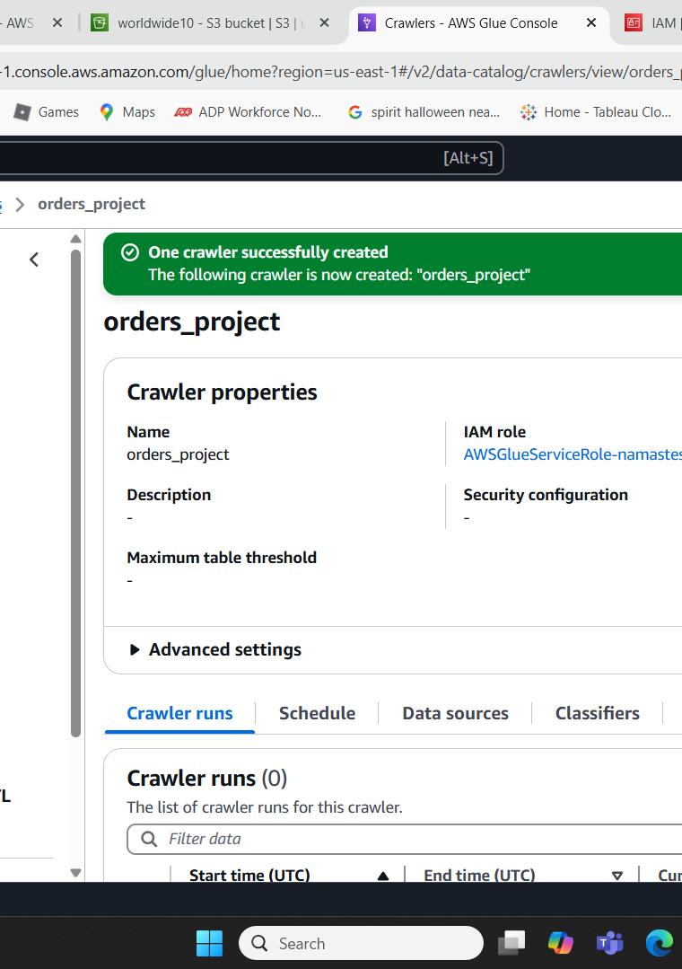
AWS Glue Crawler Creation
The AWS Glue Crawler is a critical component in the data pipeline, responsible for automatically detecting the schema of the data stored in the S3 bucket and creating a metadata catalog. This allows the team to query the data using SQL-based tools like Amazon Athena without the need for manual database creation and management.

Slide 6
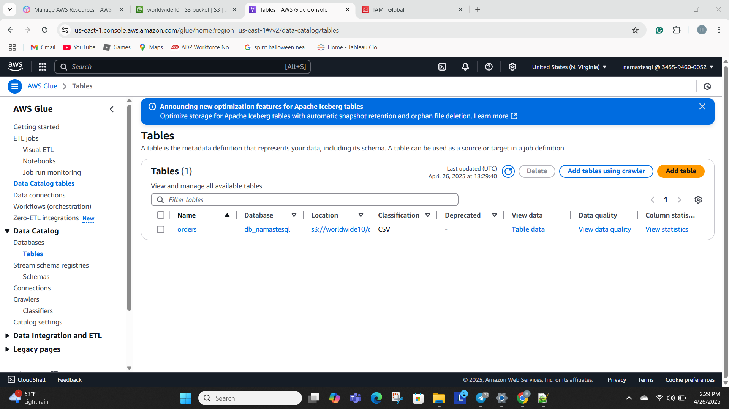
Glue Crawler Results and Partitioning

Slide 7




Querying Structured Data with Amazon Athena
Connected Athena to the Glue Data Catalog
Ran validation queries
Serverless querying
Pay-per-query pricing model
Executed queries like SELECT * FROM orders LIMIT 10 to preview the data and confirm correct ingestion.
Used Athena's serverless architecture, eliminating the need for manual infrastructure setup and management.
Leveraged the metadata catalog created by the Glue crawler to access the orders table in Athena.
Athena charges only for the data scanned, providing a cost-effective solution for ad-hoc data querying.
Athena's serverless and cost-effective querying capabilities allowed the team to easily explore and analyze the retail data, without the overhead of setting up traditional database infrastructure.

Slide 8







Running Analytical Queries with Athena
Sales by Product Category
Revenue Trends over Time
Customer Segmentation Analysis
Sales Optimization Opportunities

Slide 9
Key AWS Services in the Solution
Amazon S3
Object storage service used to upload and store the superstore dataset.
AWS Glue
Managed ETL service used to automate schema discovery and create a metadata catalog for the orders table.
Amazon Athena
Serverless query engine used to interactively analyze the data stored in Amazon S3 using standard SQL.

Slide 10




Implementation Challenges and Problem Solving
Challenge 1: Correct Folder Naming for Partition Detection
Challenge 2: Setting Up Query Result Locations in Athena
Challenge 3: IAM Permissions
Problem-Solving Approach
Importance of using snapshot_day=YYYY-MM-DD format to enable proper partition detection by the AWS Glue crawler.
Needed to configure an S3 output folder for storing the results of queries executed in Amazon Athena.
Created proper AWS Glue service roles with the necessary permissions to access the S3 buckets used in the project.
The team followed a systematic approach to troubleshoot the challenges, including carefully reviewing AWS documentation, watching YouTube tutorials, and conducting trial-and-error tests with small datasets.

Slide 11


Real-World Company Examples

Slide 12



Challenges During the Project Execution
Glue crawler timing out
Reviewing AWS Glue documentation
Initial issues with wrong path settings caused Glue crawler timeouts
Carefully studied the AWS Glue documentation to understand the correct crawler setup
Checking S3 paths multiple times
Had to recheck the S3 bucket and folder paths repeatedly to ensure correct configuration
Breaking down tasks into smaller steps
Broke down the workflow into small steps - upload to S3 first, then set up Glue, then Athena - to troubleshoot more effectively
The project execution faced some technical frustrations, but the team was able to overcome these challenges through careful documentation review, systematic troubleshooting, and a step-by-step approach to setting up the AWS services.

Slide 13

Key Learnings and Reflection
The project provided valuable insights and learning experiences for the team. The biggest takeaways were the importance of data organization, particularly partitioning and folder structure, as well as the benefits of serverless querying to save costs and time. The team also gained hands-on experience with setting up AWS cloud infrastructure, highlighting the crucial role of IAM role permissions in a cloud environment.

Slide 14
Career Implications
Proficiency levels in key AWS cloud skills
85%
80%
73%
65%
71%
AWS S3 Data Management
AWS Glue Crawler Setup
AWS Athena Querying
Cloud Data Pipeline Design
Serverless Architecture Principles

Slide 15
References
AWS Glue Documentation
Official AWS documentation for the Glue service, which provides information on using Glue to automate ETL and data cataloging.
(https://docs.aws.amazon.com/glue/)
AWS Athena Documentation
Official AWS documentation for the Athena service, which provides details on using Athena for serverless SQL-based querying of data in S3
.(https://docs.aws.amazon.com/athena/)
AWS S3 Documentation
Official AWS documentation for the S3 service guides using S3 for scalable object storage and data management.
(https://docs.aws.amazon.com/s3/)

